Slide 1
CS 331
More about Classes
MD Romael Haque

Slide 2
Static Members
If a member variable is declared static, all objects of that class have access to that variable.
If a member function is declared static, it may be called before any instances of the class are defined.

Slide 3
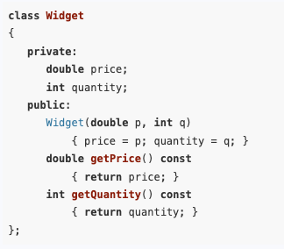
Static Members
By default, each class object (an instance of a class) has its own copy of the class’s member variables.
An object’s member variables are separate and distinct from the member variables of other objects of the same class.

Slide 4

Static Members
Now, Assume that in a program, two separate instances of the Widget class are created by the following declaration:
Widget w1(14.50, 100), w2(12.75, 500);
This statement creates w1 and w2, two distinct objects. Each has its own price and quantity member variables.
cout << w1.getQuantity() << " " << w2.getQuantity();
//will return the value 100 500

Slide 5
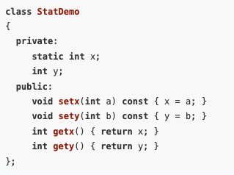
Static Member Variables
It’s possible to create a member variable that is shared by all the objects of the same class.
To create such a member, simply place the key word static in front of the variable declaration

Slide 6
Static Member Variables
Now we define x outside class
int StatDemo::x;
In this example, the member variable x will be shared by all objects of the StatDemo class.
When one class object puts a value in x, it will appear in all other StatDemo objects.

Slide 7
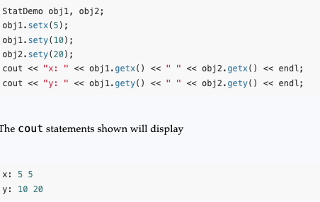
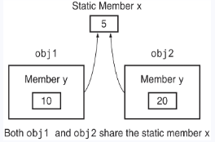
Static Member Variables
Now we define x outside class
int StatDemo::x;
In this example, the member variable x will be shared by all objects of the StatDemo class.
When one class object puts a value in x, it will appear in all other StatDemo objects.

Slide 8
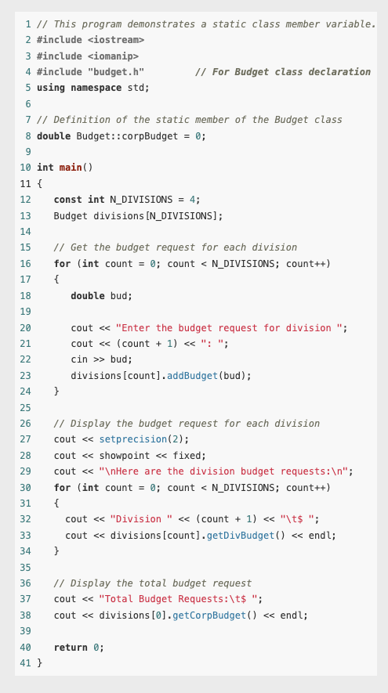
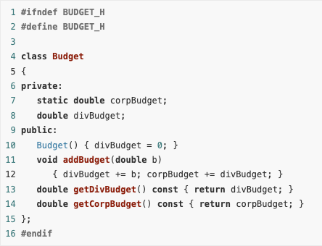
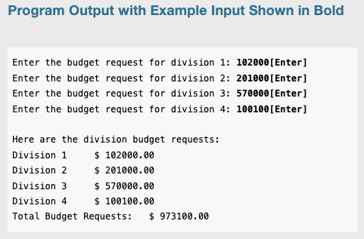
Example

Slide 9
Static Member Variables
Static member variables furnish a good example of the distinction between C++ declarations and C++ definitions.
A declaration provides information about the existence and type of a variable or function.
A definition provides all the information contained in a declaration and, in addition, causes memory to be allocated for the variable or function being defined.
Static member variables must be declared inside the class and defined outside of it.

Slide 10
Static Member Variables
In general, we can divide the member variables and functions of a class into two groups: instance members and static members.
An instance member is one whose use must be associated with a particular instance of the class. In particular, an instance variable of a class must be accessed through a specific instance of its class, and an instance member function must be called through a specific instance of its class.
In contrast, the use of a static member variable, or the call of a static member function, does not need to be associated with any instance. Only the class of the static member needs to be specified.

Slide 11
Static Member Functions
A member function of a class can be declared static by prefixing its declaration with the key word static.
static <return type><function name>(<parameter list>)
Static member functions are normally used to work with static member variables of the class. In fact, member functions that do not access any nonstatic members of their class

Slide 12
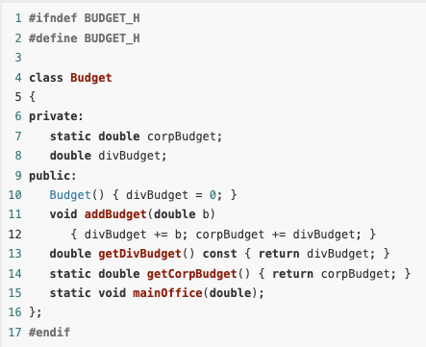
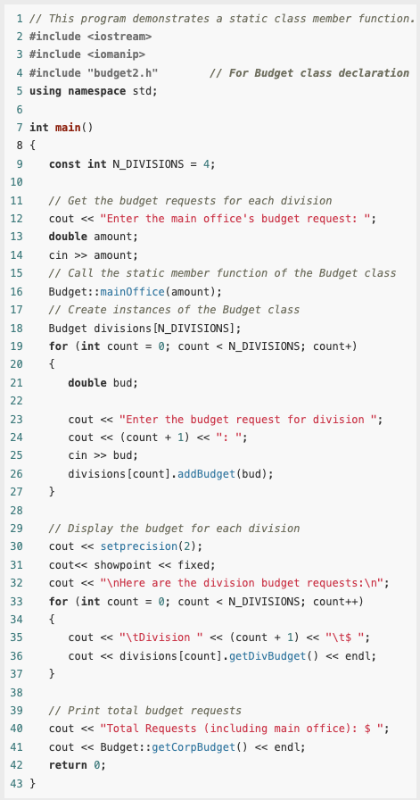
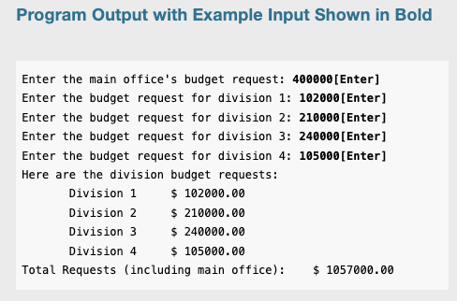
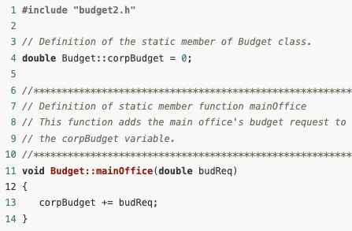
Example

Slide 13
Example
Notice the statement that calls the static function mainOffice:
Budget::mainOffice(amount);
Calls to static member functions are normally made by connecting the function name to the class name with the scope resolution operator.
If objects of the class have been defined, static member functions can also be called by connecting their names to the object with the dot operator.
Thus, the last output statement of yhis program could be written as
cout << divisions[0].getCorpBudget() << endl;

Slide 14
Static member function
The this pointer cannot be used in a static member function because static member functions are not called through any instance of their class.
Moreover, a static member function cannot access an instance member of its class unless it specifies what instance the member belongs to.

Slide 15
Static member function
An advantage of static member functions is that they can be called before any instances of the class have been created.
This allows them to be used to perform complex initialization tasks that have to be done before objects of the class have been created.

Slide 16
Static Members
C++ uses the key word static to describe both static class members and static local variables.
To understand why, it is helpful to look at the distinction between instance and static class members.
Each object of the class has its own copy of the instance members, but all objects share the same static members.
Similarly, each call to a function has its own copy of the non-static local variables, but all function calls share the same static local variables.
In this analogy, the function definition corresponds to the class, function calls correspond to objects of the class, and non-static local variables correspond to instance members.

Slide 17
Friends of Classes
Private members are hidden from all parts of the program outside the class, and accessing them requires a call to a public member function.
Sometimes you will want to create an exception to that rule.
A friend function is a function that is not a member of a class but that has access to the class’s private members.
In other words, a friend function is treated as if it were a member of the class. A friend function can be a regular stand-alone function, or it can be a member of another class. (In fact, an entire class can be declared a friend of another class.)

Slide 18
Friends of Classes
In order for a function or class to become a friend of another class, it must be declared as such by the class granting it access.
Classes keep a “list” of their friends, and only the external functions or classes whose names appear in the list are granted access.
A function is declared a friend by placing the key word friend in front of a prototype of the function. Here is the general format:
friend <return type><function name>(<parameter type list>);

Slide 19
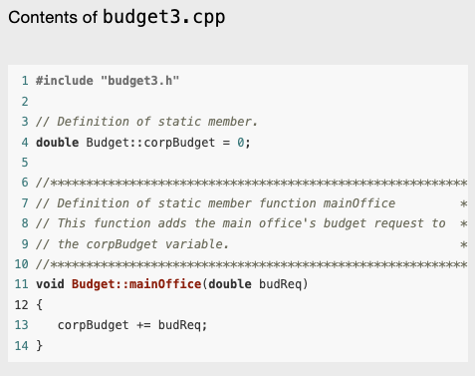
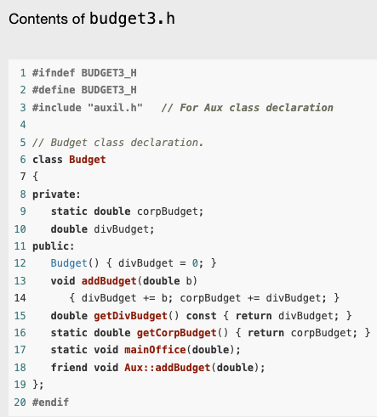
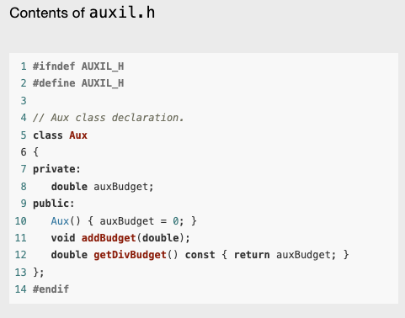
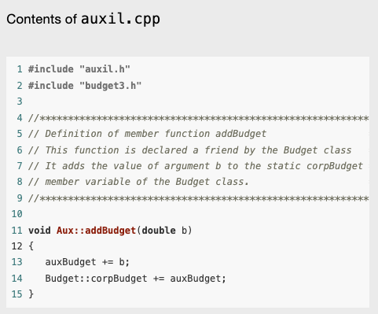
Example

Slide 20
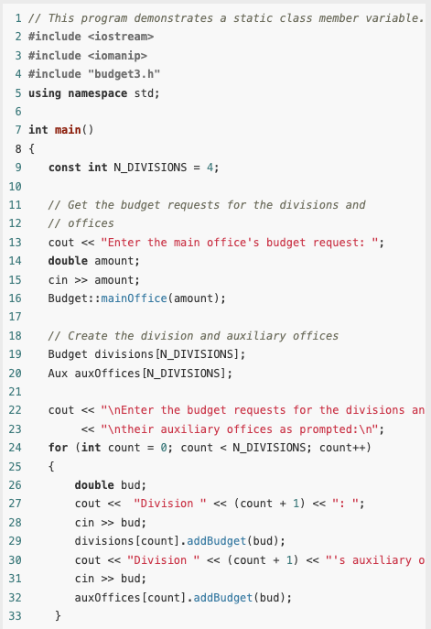
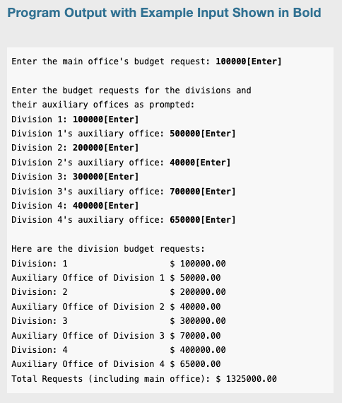
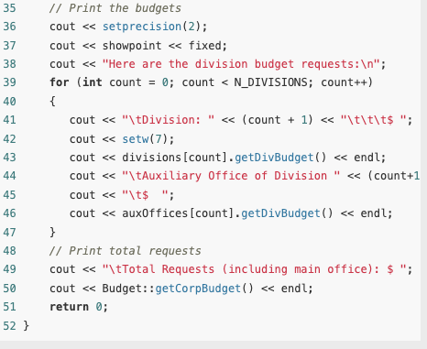
Example (contd.)

Slide 21
Friends of Classes
As mentioned before, it is possible to make an entire class a friend of another class. The Budget class could make the Aux class its friend with the following declaration:
friend class Aux;
This may not be a good idea, however. Every member function of Aux (including ones that may be added later) would have access to the private members of Budget.
The best practice is to declare as friends only those functions that must have access to the private members of the class.

Slide 22
Memberwise Assignment
The = operator may be used to assign one object to another, or to initialize one object with another object’s data. By default, each member of one object is copied to its counterpart in the other object.
The = operator may be used to assign one object to another, or to initialize one object with another object’s data. By default, each member of one object is copied to its counterpart in the other object.
Let’s look at an example

Slide 23
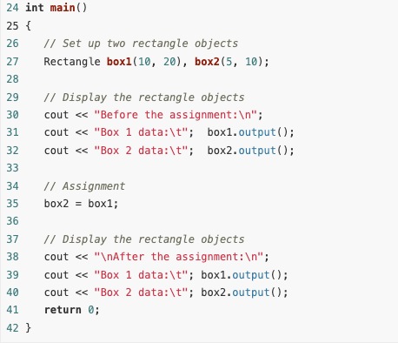
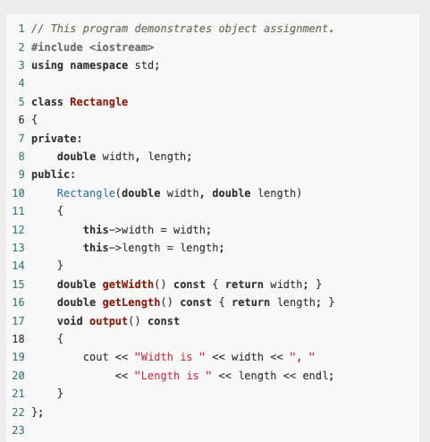
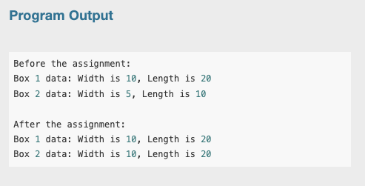
Example
As you can see, the statement
box2 = box1
copied the width and length variables of box1 directly into the width and length variables of box2.

Slide 24
Memberwise Assignment
Memberwise assignment also occurs when one object is initialized with another object’s values.
Remember the difference between assignment and initialization: Assignment occurs between two objects that already exist, and initialization happens to an object being created.
Consider the following program segment:
Rectangle box1(10, 50);
Rectangle box2 = box1;
The second statement defines a Rectangle object box2 and initializes it to the values stored in box1. Because memberwise assignment takes place, the box2 object will contain the same values as the box1 object.

Slide 25
Copy Constructors
A copy constructor is a special constructor that is called whenever a new object is created and initialized with the data of another object of the same class.
Many times it makes sense to create an object and have it start out with its data being the same as that of another, previously created object.
Consider the following example -

Slide 26
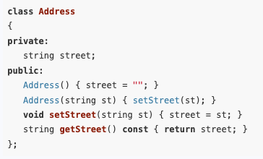

Copy Constructors
For example, if Mary and Joan live in the same house and an address object for Mary has already been created, it makes sense to initialize Joan’s address object to a copy of Mary’s.

Slide 27
Copy Constructors
Recall that a constructor must execute whenever an object is being created.
When an object is created and initialized with another object of the same class, the compiler automatically calls a special constructor, called a copy constructor, to perform the initialization using the existing object’s data.
This copy constructor can be specified by the programmer as well

Slide 28
The Default Copy Constructor
If the programmer does not specify a copy constructor for the class, then the compiler automatically calls a default copy constructor.
This default copy constructor simply copies the data of the existing object to the new object using memberwise assignment.
Most of the time, the default copy constructor provides the kind of behavior that we want.
For example, if after initializing Joan’s address with Mary’s, Joan later moves out and gets her own place, we can change Joan’s address without affecting Mary’s.

Slide 29
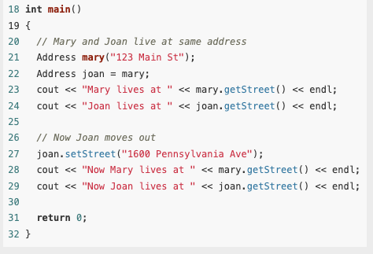
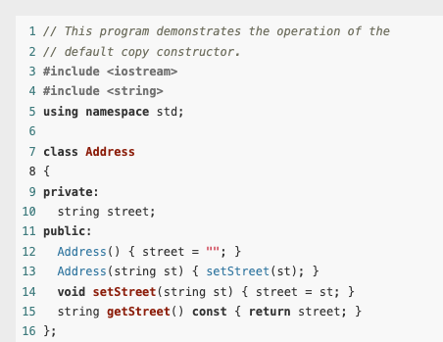
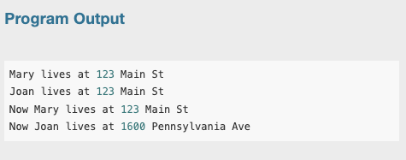
Example

Slide 30
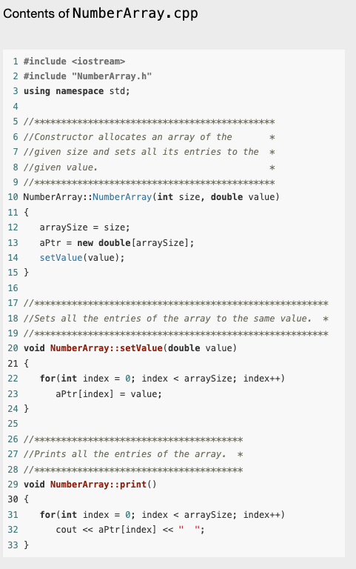
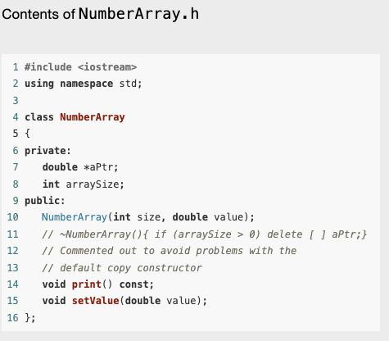
Deficiencies of Default Copy Constructors
Here’s a class that encapsulates an array of numbers of type double.
To allow flexibility for different size arrays, the class contains a pointer to the array instead of directly containing the array itself.
The constructor of the class, allocates an array of a specified size, then sets all the entries of the array to a given value.
The class has member functions for printing the array and for setting the entries of the array to a given value.

Slide 31
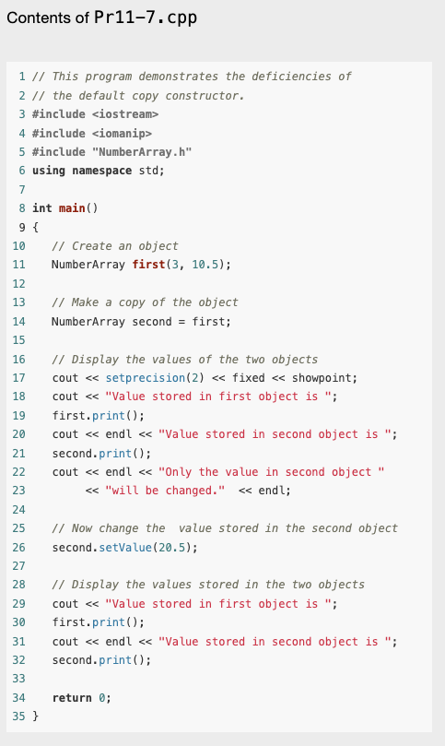
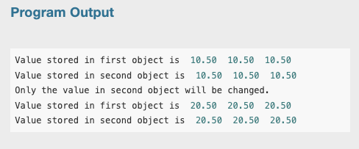
Deficiencies of Default Copy Constructors
In the main program,
It creates an object of the class, creates and initializes a second object with the data of the first, and then changes the array in the second object.
As shown by the output of the program, changing the second object’s data changes the data in the first object.
In many cases, this is undesirable and leads to bugs.

Slide 32

Why is that?
The reason changing the data in one object changes the other object is that the memberwise assignment performed by the default copy constructor copies the value of the pointer in the first object to the pointer in the second object, leaving both pointers pointing to the same data.
Thus, when one of the objects changes its data through its pointer, it affects the other object as well.
The fact that the two pointers point to the same memory location will also cause problems when the destructors for the two objects try to deallocate the same memory.
In general, classes with pointer members will not behave correctly under the default copy constructor provided by the compiler.
They must be provided with a copy constructor written by the programmer.

Slide 33
Programmer-Defined Copy Constructors
A programmer can define a copy constructor for a class. A programmer-defined copy constructor must have a single parameter that is a reference to the same class.
Thus, in the case of the previous example, the prototype for the copy constructor would be
NumberArray::NumberArray(const NumberArray &obj)

Slide 34
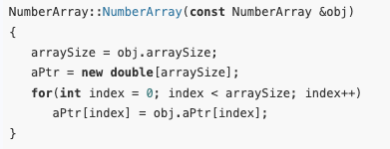
Programmer-Defined Copy Constructors
The copy constructor avoids the problems of the default copy constructor by allocating separate memory for the pointer of the new object before doing the copy.
The copy constructor should not change the object being copied, so it declares its argument as const

Slide 35
Programmer-Defined Copy Constructors
The parameter should be a const reference because the copy constuctor should not modify the object being copied.
The copy constructor is also automatically called by the compiler to create a copy of an object whenever an object is being passed by value in a function call.
It is for this reason that the parameter to the copy constructor must be passed by reference.
If it was passed by value when the constructor was called, then the constructor would immediately have to be called again to create the copy to be passed by value, leading to an endless chain of calls to the constructor.

Slide 36
Invocation of Copy Constructors
Copy constructors are automatically called by the system whenever an object is being created by initializing it with another object of the same class.
For example, the copy constructor for the Rectangle class is called for each of the following initialization statements:
Rectangle box(5, 10);
Rectangle b = box; // Initialization statement
Rectangle b1(box); // Initialization statement

Slide 37
Invocation of Copy Constructors
Copy constructors are also automatically called when a function call receives a value parameter of the class type. For example, for a function of the form and a call
void fun(Rectangle rect) { }
fun(box);
It will cause the Rectangle copy constructor to be called.

Slide 38
Invocation of Copy Constructors
Finally, copy constructors are automatically called whenever a function returns an object of the class by value.
The copy constructor will be called when the return statement is executed.
This is because the return statement must create a temporary, nonlocal copy of the object that will be available to the caller after the function returns.
Rectangle makeRectangle()
{
Rectangle rect(12, 3);
return rect;
}

Slide 39
Invocation of Copy Constructors
To summarize, a class copy constructor is called when
A variable is being initialized from an object of the same class
A function is called with a value parameter of the class
A function is returning a value that is an object of the class
Copy constructors are not called when a parameter of the class is passed by reference or through a pointer, nor are they called when a function returns a reference or pointer to an object of the class.

Slide 40
Operator Overloading
As we have seen, copy constructors are designed to solve problems that arise when an object containing a pointer is initialized with the data of another object of the same class using memberwise assignment.
Similar problems arise in object assignment.

Slide 41
Operator Overloading
For example, with the NumberArray class of the previous section, we may have a program that has defined two objects of that class:
NumberArray first(3, 10.5);
NumberArray second(5, 20.5);
first = second;
If we want to set the first object to exactly the same value as the second.
At this point, C++ will once again perform a memberwise copy from the second to the first object, leaving pointers in both objects pointing to the same memory.

Slide 42
Operator Overloading
Because the default object assignment encounters the same problem as the default copy constructor, we might think that a programmer-defined copy constructor can be used to solve the problem caused by the default assignment, but this is not so.
Copy constructors only come into play when an object is being initialized at creation time.
In particular, copy constructors are not called in an assignment.

Slide 43
Operator Overloading
To see the difference between initialization and assignment, suppose that the object first has already been created.
Then the statement -
NumberArray second = first; // copy constructor called
which creates second and initializes it with the value of first, is an initialization and causes the copy constructor to be called to perform the initialization.
However, the statement –
second = first; // copy constructor not called
which assumes that both objects have previously been created, is an assignment, and therefore no constructor is invoked.

Slide 44
Operator Overloading
To address the problems that result from memberwise assignment of objects, we need to modify the behavior of the assignment operator so that it does something other than memberwise assignment when it is applied to objects of classes that have pointer members.
In effect we are supplying a different version of the assignment operator to be used for objects of that class.
In so doing, we say that we are overloading the assignment operator.

Slide 45
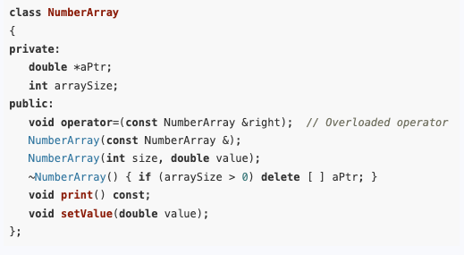
Operator Overloading
One way to overload the assignment operator for a given class is to define an operator function called operator= as a member function of the class

Slide 46
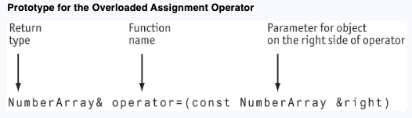
Operator Overloading
Let’s take a look at the function header, or prototype, before we look at how the operator function itself is implemented.

Slide 47
Operator Overloading
The name of the function is operator=.
Since the operator function is an instance member of a class, it can only be called through an object of the class.
The object of the class through which it is called is considered the left operand of the assignment operator, while the parameter passed to the function is considered the right operand of the assignment operator.

Slide 48
Operator Overloading
To illustrate, let us suppose that two objects, left and right, have been defined in a program
NumberArray left(3,10.5);
NumberArray right(5, 20.5);
To assign the value of right to left, we call the member function operator= through the left object, and pass it the right object as parameter:
left.operator=(right);
While you can call operator functions this way, the compiler will also let you use the more conventional notation
left = right;

Slide 49
Operator Overloading
Parameters to operator functions do not have to be passed by reference, nor do they have to be declared const.
In the example, we have used a reference parameter for efficiency reasons:
Reference parameters avoid the overhead of copying the object being passed as parameter.
The const is used to protect the parameter from change.

Slide 50
Implementation of the Class Assignment Operator
Let us now consider the implementation of assignment operator. First notice that there is no need to do any copying if a statement such as x = x;
It is resulting in an object being assigned to itself.
We can test for this possibility by checking that the address this of the object on the left side of the assignment is different from the address of the object on the right side like this:
if(this != &right) { /* copy the object …*/ }

Slide 51
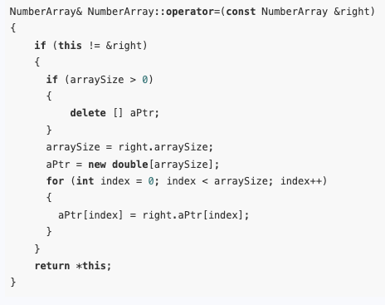
Implementation of the Class Assignment Operator
The assignment operator function starts by deleting the memory allocated to pointers in the object being assigned to.
After that, it makes a copy of the other object in much the same way as the copy constructor for the class.
The last act of the function is to return (by reference) the object *this on the left side of the assignment.

Slide 52
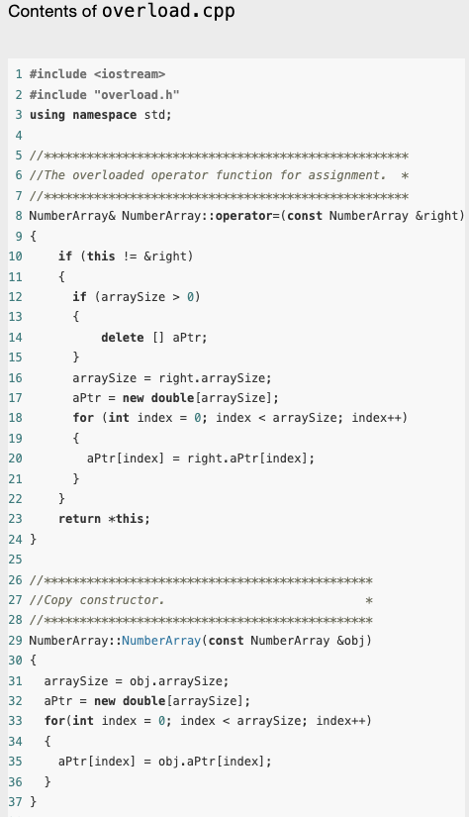
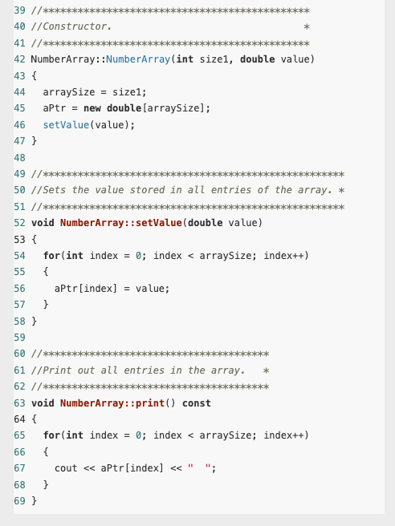
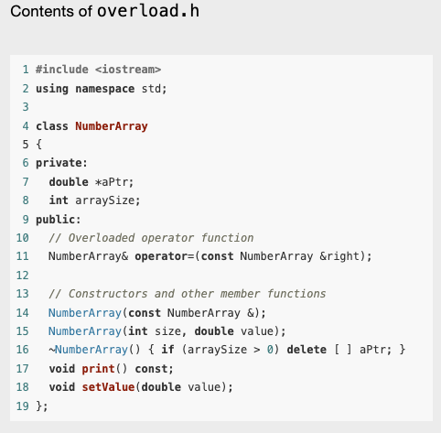
Example

Slide 53
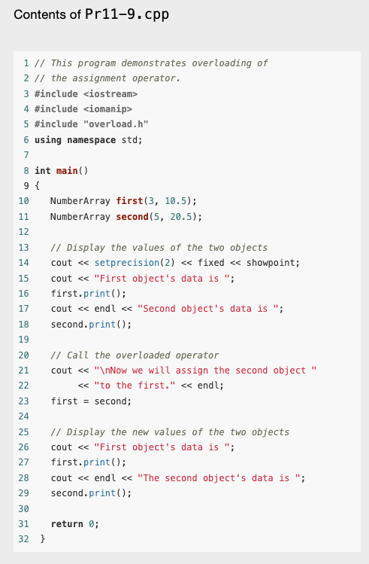
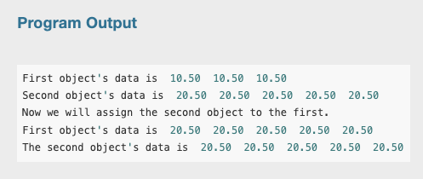
Example

